Slide 1

Operating Systems Design​ Session 27: Swapping and Demand Paging
19CS2106R​
© 2020 KL University

Slide 2
Swapping and Demand Paging
UNIX systems transferred entire processes between primary memory and the swap device, but did not transfer parts of a process independently, except for shared text. Such a memory management policy is called swapping.
Demand paging, transferring memory pages instead of processes to and from a secondary device.
The advantage of a demand paging policy is that it permits greater flexibility in mapping the virtual address space of a process into the physical memory of a machine, usually allowing the size of a process to be greater than the amount of available physical memory and allowing more processes to fit simultaneously in main memory.
The advantage of a swapping policy is that it is easier to implement and results in less system overhead.

Slide 3
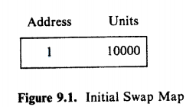
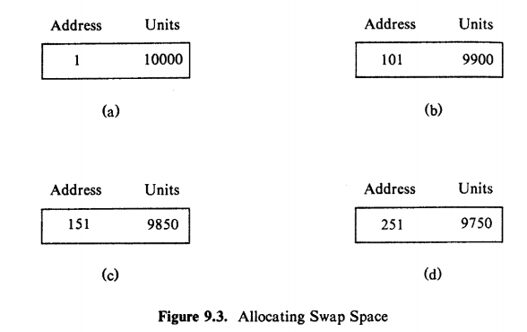
Allocation on swap space – malloc
The free space for the swap device is maintained in an in-core table, called a map.
A map is an array where each entry consists of an address of an allocatable resource and the number of resource units available there.
The algorithm malloc for allocating space from maps.
The kernel searches the map for the first entry that contains enough space to accommodate the request.
Figure 9.3 shows the sequence of swap map configurations after allocating 100 units, 50 units, then 100 units again.

Slide 4
malloc
algorithm malloc /* algorithm to allocate map space */
input: (1) map address /* indicates which map to use 'V
(2) requested number of units
output: address, if successful 0, otherwise
{
for (every map entry)
{
if (current map entry can fit requested units)
{
if (requested units = number of units in entry)
delete entry from map;
else
adjust start address of entry;
return (original address of entry);
}
}
return (0);
}

Slide 5
Swapping Process in - Swapper
Process 0, the swapper, is the only process that swaps processes into memory from swap devices.
At the conclusion of system initialization, the swapper goes into an infinite loop, where its only task is to do process swapping.
It attempts to swap processes in from the swap device, and it swaps processes out if it needs space in main memory.
The swapper sleeps if there is no work for it to do (for example, if there are no processes to swap in) or if it is unable to do any work (there are no processes eligible to swap out); the kernel periodically wakes it up, as will be seen.

Slide 6
Swapping Processes Out - Swapper
The kernel swaps a process out if it needs space in memory, which may result from any of the following:
The fork system call must allocate space for a child process
The brk system call increases the size of a process
A process becomes larger by the natural growth of its stack
The kernel wants to free space in memory for processes it had previously swapped out and should now swap in.

Slide 7
algorithm swapper /* swap in swapped out processes,
* swap out other processes to make room */
input: none
output: none
{
loop:
for (all swapped out processes that are ready to run)
pick process swapped out longest;
if (no such process)
{
sleep (event must swap in);
goto loop;
}
if (enough room in main memory for process)
{
swap process in;
goto loop;
}
/*
Swapper
When the swapper wakes up to swap processes in, it examines all processes that are in the state "ready to run but swapped out" and selects one that has been swapped out the longest
No "ready-to-run" processes exist on the swap device: The swapper goes to sleep until a process on the swap device wakes up or until the kernel swaps out a process that is "ready to run."

Slide 8
Swapper
swap out
1f the swapper must swap a process out,
The kernel swaps out sleeping processes rather than those "ready to run,"
loop2; here in revised algorithm */
for (all processes loaded in main memory, not zombie and not locked in memory)
{
if (there is a sleeping process)
choose process such that priority + residence time is numerically highest;
else /* no sleeping processes */
choose process such that residence time + nice is numerically highest;
}
if (chosen process not sleeping or residency requirements not satisfied)
sleep (event must swap process in);
else
swap out process;
goto loop2;
/* goto loop2 in revised algorithm */
A "ready-to-run" process must be core resident for at least 2 seconds before being swapped out, and a process to be swapped in must have been swapped out for at least 2 seconds.

Slide 9
Demand Paging
Demand paging systems free processes from size limitations otherwise imposed by the amount of physical memory available on a machine
Processes tend to execute instructions in small portions of their text space, such as program loops and frequently called subroutines, and their data references tend to cluster in small subsets of the total data space of the process. This is known as the principle of "locality."
working set of a process is the set of pages that the process has referenced in its last n memory references; the number n is called the window of the working set.
When a process addresses a page that is not in its working set, it incurs a page fault;
In handling the fault, the kernel updates the working set, reading in pages from a secondary device if necessary

Slide 10
Yield
2826 // Give up the CPU for one scheduling round.
2827 void
2828 yield(void)
2829 {
2830 acquire(&ptable.lock);
2831 myproc()−>state = RUNNABLE;
2832 sched();
2833 release(&ptable.lock);
2834 }

Slide 11
vm.c
1712 // Set up CPU’s kernel segment descriptors.
1713 // Run once on entry on each CPU.
1714 void
1715 seginit(void)
1716 {
1717 struct cpu *c;
1718
1719 // Map "logical" addresses to virtual addresses using identity map.
1720 // Cannot share a CODE descriptor for both kernel and user
1721 // because it would have to have DPL_USR, but the CPU forbids
1722 // an interrupt from CPL=0 to DPL=3.
1723 c = &cpus[cpuid()];
1724 c−>gdt[SEG_KCODE] = SEG(STA_X|STA_R, 0, 0xffffffff, 0);
1725 c−>gdt[SEG_KDATA] = SEG(STA_W, 0, 0xffffffff, 0);
1726 c−>gdt[SEG_UCODE] = SEG(STA_X|STA_R, 0, 0xffffffff, DPL_USER);
1727 c−>gdt[SEG_UDATA] = SEG(STA_W, 0, 0xffffffff, DPL_USER);
1728 lgdt(c−>gdt, sizeof(c−>gdt));
1729 }
First Part
Defines Segments in GDT

Slide 12
vm.c
1731 // Return the address of the PTE in page table pgdir
1732 // that corresponds to virtual address va. If alloc!=0,
1733 // create any required page table pages.
1734 static pte_t *
1735 walkpgdir(pde_t *pgdir, const void *va, int alloc) – Session 22
1756 // Create PTEs for virtual addresses starting at va that refer to
1757 // physical addresses starting at pa. va and size might not
1758 // be page−aligned.
1759 static int
1760 mappages(pde_t *pgdir, void *va, uint size, uint pa, int perm) – Session 22
1802 // This table defines the kernel’s mappings, which are present in
1803 // every process’s page table.
1804 static struct kmap {

Slide 13
vm.c
1837 // Allocate one page table for the machine for the kernel address
1838 // space for scheduler processes.
1839 void
1840 kvmalloc(void) - Session 22
1816 // Set up kernel part of a page table.
1817 pde_t*
1818 setupkvm(void) - Session 22
1858 // Switch TSS and h/w page table to correspond to process p.
1859 void
1860 switchuvm(struct proc *p)
1883 // Load the initcode into address 0 of pgdir.
1884 // sz must be less than a page.
1885 void
1886 inituvm(pde_t *pgdir, char *init, uint sz)
1902 int
1903 loaduvm(pde_t *pgdir, char *addr, struct inode *ip, uint offset, uint sz)
1926 int
1927 allocuvm(pde_t *pgdir, uint oldsz, uint newsz)
1960 int
1961 deallocuvm(pde_t *pgdir, uint oldsz, uint newsz)

